Slide 1
Navigating your
GREAT Grant Application
Notes:
Here is your how-to guide for submitting your application for the GREAT Grant.

Slide 2
Navigating your
GREAT Grant Application
Broadband Infrastructure Office
September 3, 2020
Notes:
"Hello, my name is _____ and I am a ____ with the Broadband Infrastructure Office within the North Carolina Department of Information Technology.”

Slide 3
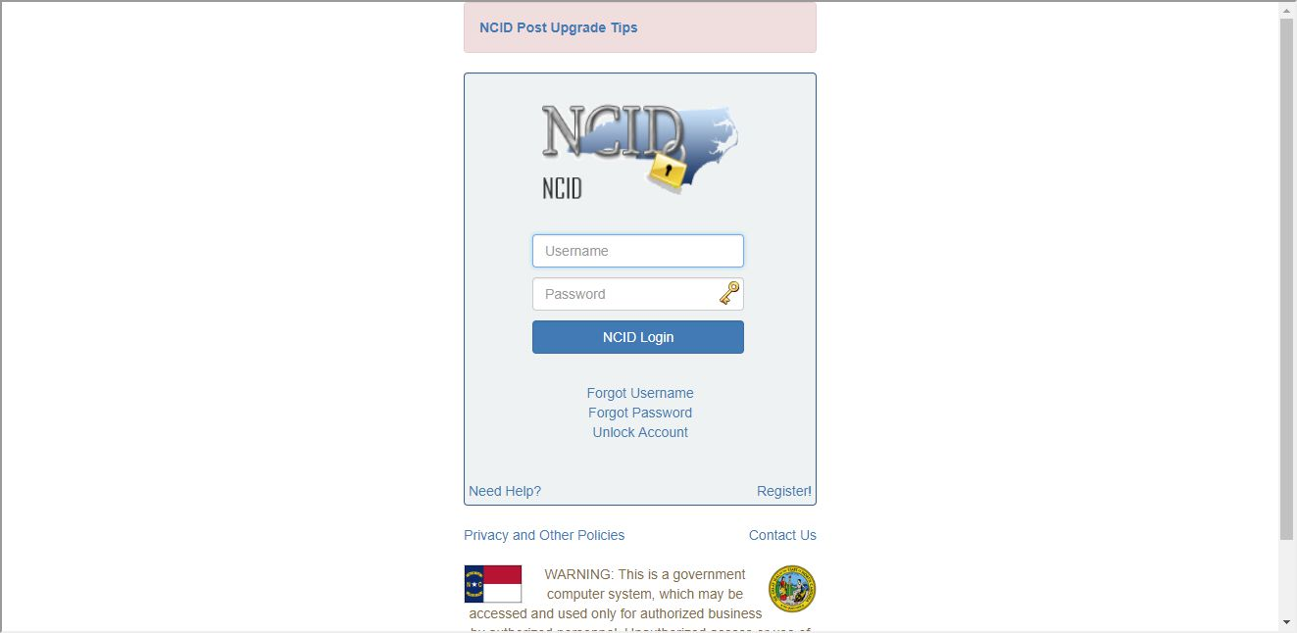
Registering your NCID

Slide 4
First, visit
https://ncid.nc.gov and click “Register” on the bottom of the form

Slide 5
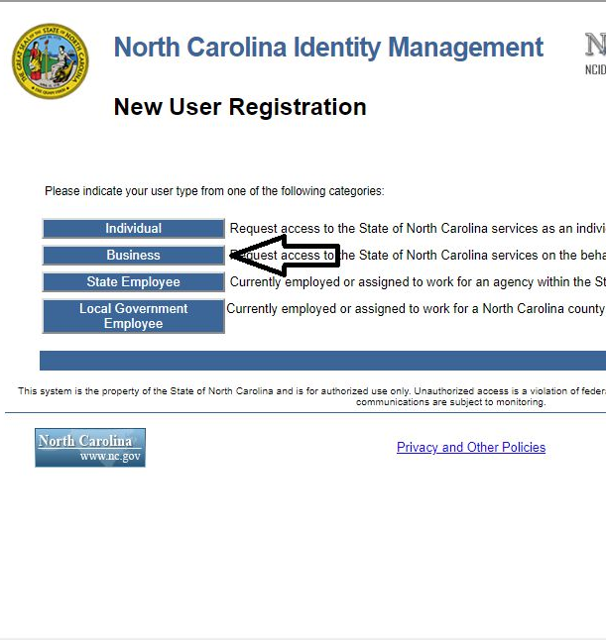
Then, Internet Service
Providers should click
“Business” to register
for a new business NCID. Each user in your organization should have their own NCID.

Slide 6
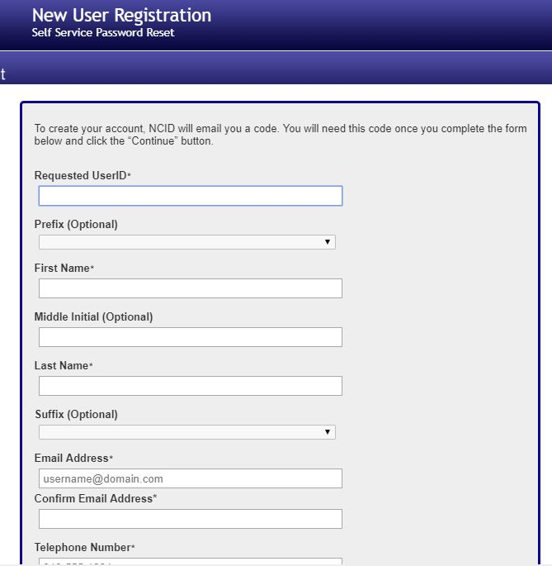
Complete all the registration information and click continue.

Slide 7
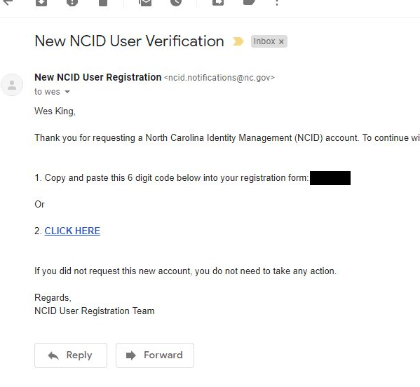
Once you complete the registration, you will receive a confirmation email with a code. You can either click the link in the email which will automatically confirm your account or copy your code from your email.

Slide 8
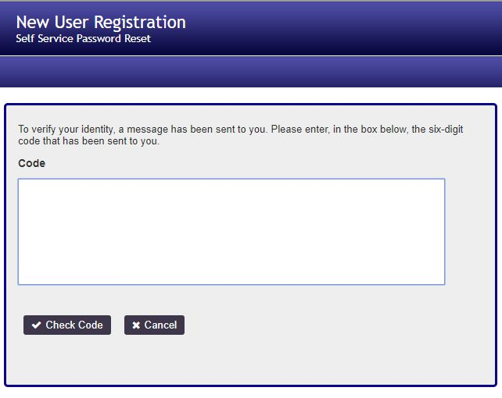
If you copied your confirmation code, enter it here and click “Check Code.”

Slide 9
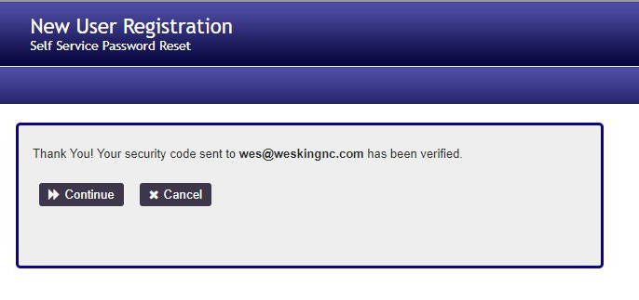
Click “Continue” once your account has been verified.

Slide 10
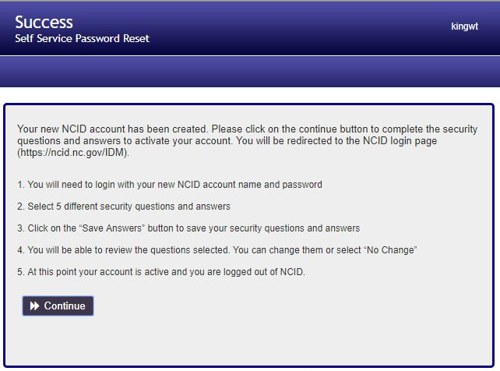
Click “Continue” to continue account registration.

Slide 11
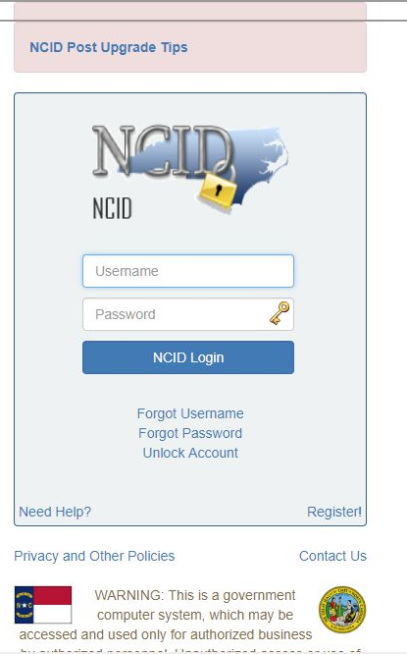
Login with your new credentials.

Slide 12
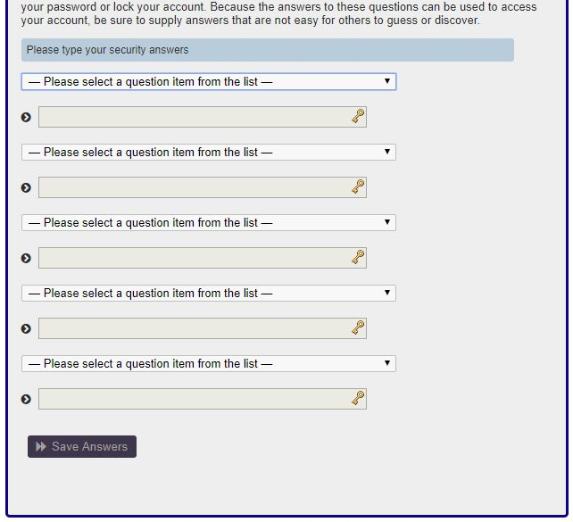
Choose 5 security questions from the drop-down menus and write their perspective answers in the boxes below.

Slide 13
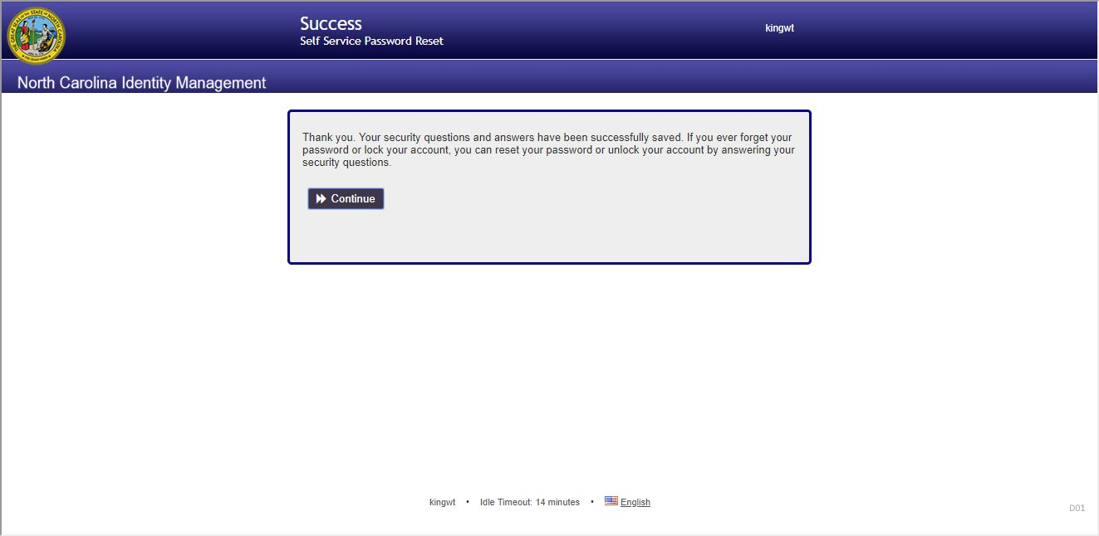
Click “Continue.”

Slide 14
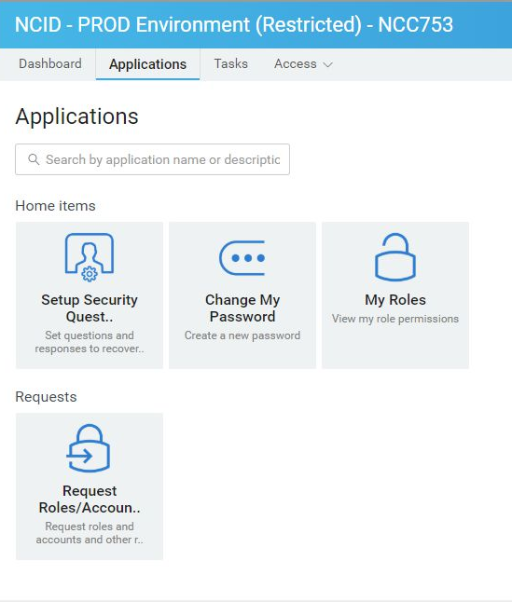
Once you arrive at this page, you have fully registered your NCID.

Slide 15
Completing your User Authentication

Slide 16
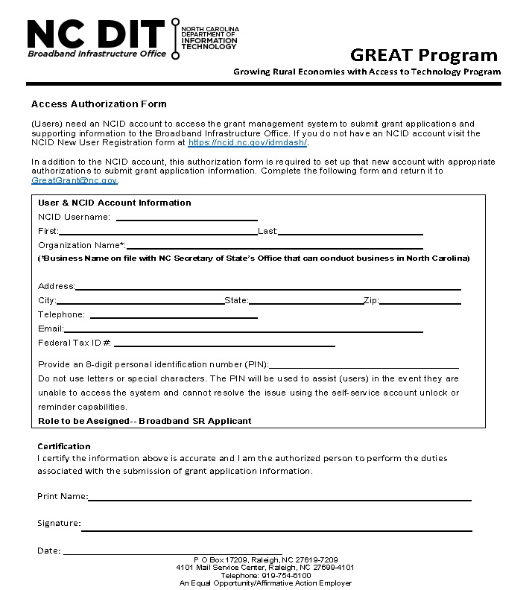
Please complete this form and submit it via email to greatgrant@nc.gov. Once the form has been filed, you will be notified that you are ready to return to ncbroadband.gov/greatgrant to start your application. If you need a copy of this form, please contact our office at greatgrant@nc.gov.

Slide 17
Get Help
GREAT Questions
GREATGrant@nc.gov
NCID Support
it.nc.gov/ncid/
919-754-6000
Notes:
If you need help along the way, here are the best ways to start. If you have issues that aren’t resolved through these sources, please contact us via email at greatgrant@nc.gov.

