Slide 1
GREAT Grant
Information Session
for
Eligible Applicants
Broadband Infrastructure Office
November 1, 2018

Slide 2
To facilitate economic development through the deployment of broadband to unserved areas of the State.
Purpose Statement

Slide 3
Today’s Objectives
Familiarize you with the Application and Process
Provide you with the Guidelines and Application materials
Answer any questions
Ensure you know where to go for answers

Slide 4
Guidelines & Program Overview
No more than one grant award per county (applications should target one county)
A single grant award shall not exceed $2,000,000
Matching funds required
5-Year Service Agreement
(including deployment period)
Provide minimum speeds of 10/1 Mbps
Deployment of speeds of 25/3 Mbps or greater is encouraged

Slide 5
Important Dates
Launch of Grant Application Portal November 9
Applications Due January 11, 2019
BIO Initial Review – Vetting for Completeness & Basic Eligibility January 11-25
Public Posting & Protest Window January 26 – February 25
Final Application Review/Scoring February 25 – March 2
Award Letters & Contracts Executed March 3 –April 30

Slide 6
Guidelines & Program Walk Through
Key Definitions
Eligible Projects & Activities
Eligible Areas
Protest Process
Scoring & Match
Contract Terms
The Portal
Q&A
Application Materials
Notes:
Q&A
Who to contact
Public posting on webpage
SAP and NCID support

Slide 7
Guidelines & Program Walk Through
Key Definitions

Slide 8
Key Definitions
Eligible Recipients: Broadband Providers & EMCs
Partnerships: Broadband provider with nonprofit, not-for-profit, or subsidiary of either to utilize resources, facilities and infrastructure to facilitate deployment and reduce costs
Eligible Counties: Tier One

Slide 9
Key Definitions
Broadband Service: Terrestrially deployed Internet access service with transmission speeds of at least 10:1 Mbps (Wireline or fixed wireless)
Unserved Area: An area without broadband service as defined above.

Slide 10
Guidelines & Program Walk Through
Eligible Projects/Activities

Slide 11
Eligible Projects/Activities
A specific project located in an unserved area, to provide broadband service to homes, businesses, and community anchor points not currently served.
Service to End Users

Slide 12
Eligible Costs
Costs directly related to the construction of broadband infrastructure and extension of service for an eligible project:
Easements (one-time fees)
Materials (fiber, equipment, etc.)
Construction/Installation
Testing

Slide 13
Ineligible Costs
Not for overhead or administrative costs
For deployment phase, not recurring operating
costs or maintenance
Backhaul infrastructure - must facilitate last-mile
service towards specific end-users
Towers - may be eligible, but applicants encouraged to utilize vertical assets already in place or easy installed as much as possible

Slide 14
Project Timeline
Deployment Project Period:
  Preferred timeline for this construction = within one year from the execution of the award
  Exact timelines subject to negotiation
5-Year Service Agreement:
  Following the deployment phase, service must continue to be made available to those households and businesses for the remainder of the five-year agreement period.

Slide 15
Guidelines & Program Walk Through
Eligible Areas

Slide 16
Eligible Areas
Areas without Internet service providing transmission speeds of 10:1 Mbps (wireline or fixed wireless) - considered “unserved”
  Like the Community Connect Program (USDA) – applicants identify the areas they wish to apply to serve
  Applicants can apply for funding to serve census blocks OR portions of census blocks
  Note: Application offers a range of ways to provide location data for projects (address-level, street segment, polygons…)

Slide 17
Ineligible Areas
Areas where a private provider has been designated to receive funds through other State or federally funded programs
  These areas shall be considered “served” if such funding is intended to result in construction of broadband in the area within 18 months
  Providers must submit data for these upcoming projects
  Failure on the part of a provider to submit the listing of census blocks by August 30th results in those areas
  being eligible for this round

Slide 18
Identifying Eligible Areas – Where to Start…
Suggested data to provide baseline information as you develop your areas:
  Census block boundaries in the Tier One counties
  Census blocks with less then 10/1 Mbps, according to the FCC Form 477 Data (entire blocks)
  Ineligible blocks
  CAF Eligible Areas (original CAF eligible areas from FCC)
  Location data for CAF builds to-date

Slide 19
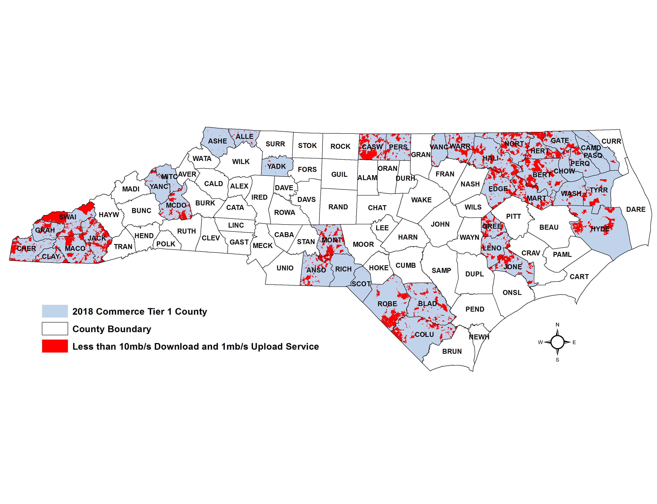
Baseline Data for Identifying Eligible Areas
Tier One counties
Census block boundaries
Census blocks with less than 10/1 Advertised Speeds
Mapped GIS layers available for download

Slide 20
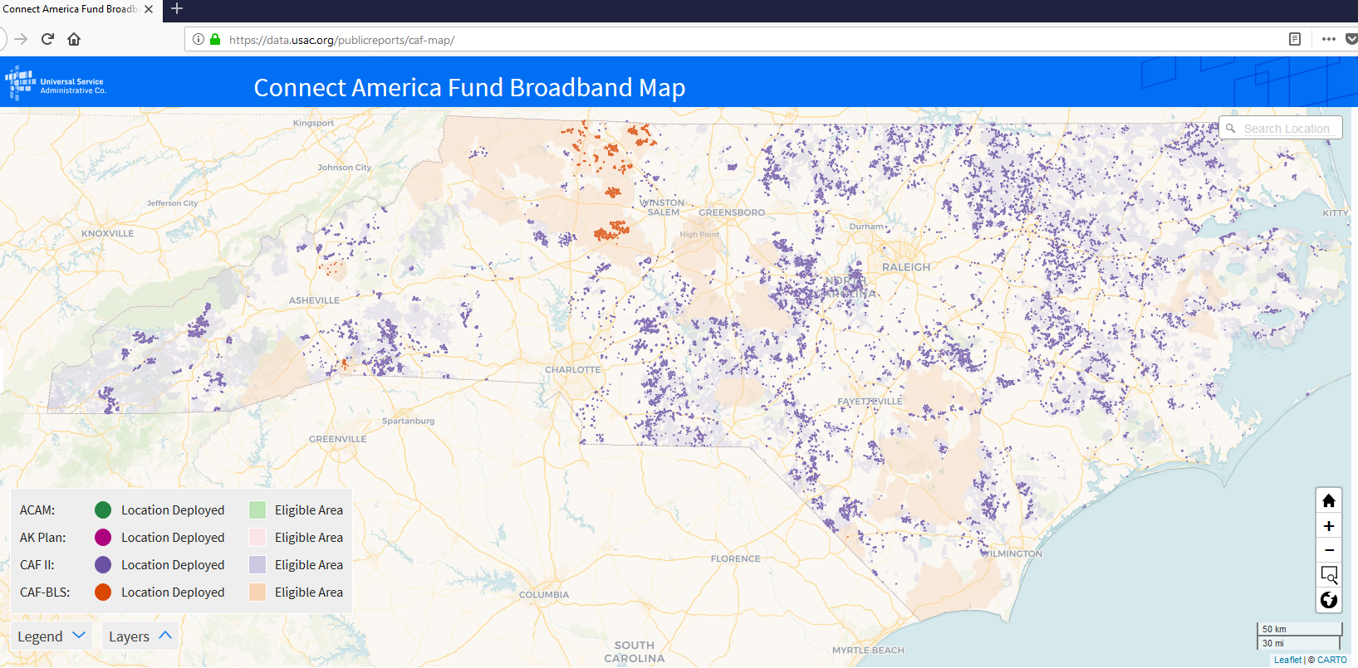
Identifying Eligible Areas

Slide 21
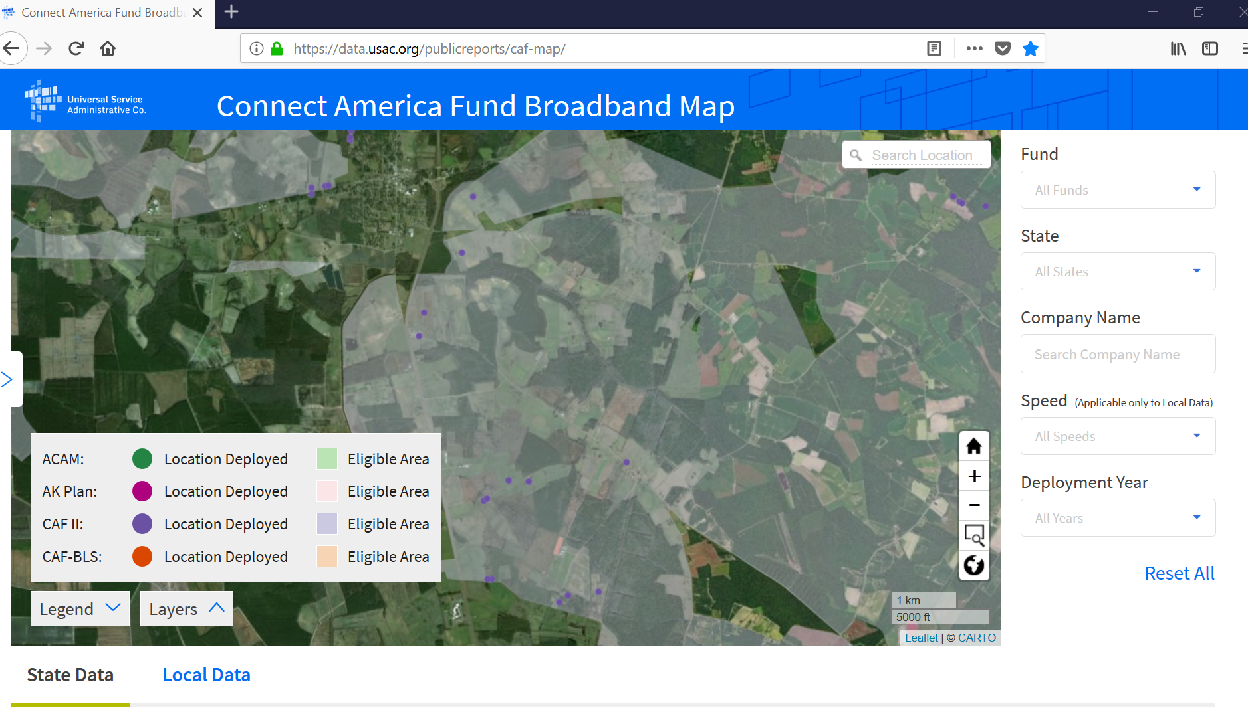

Slide 22
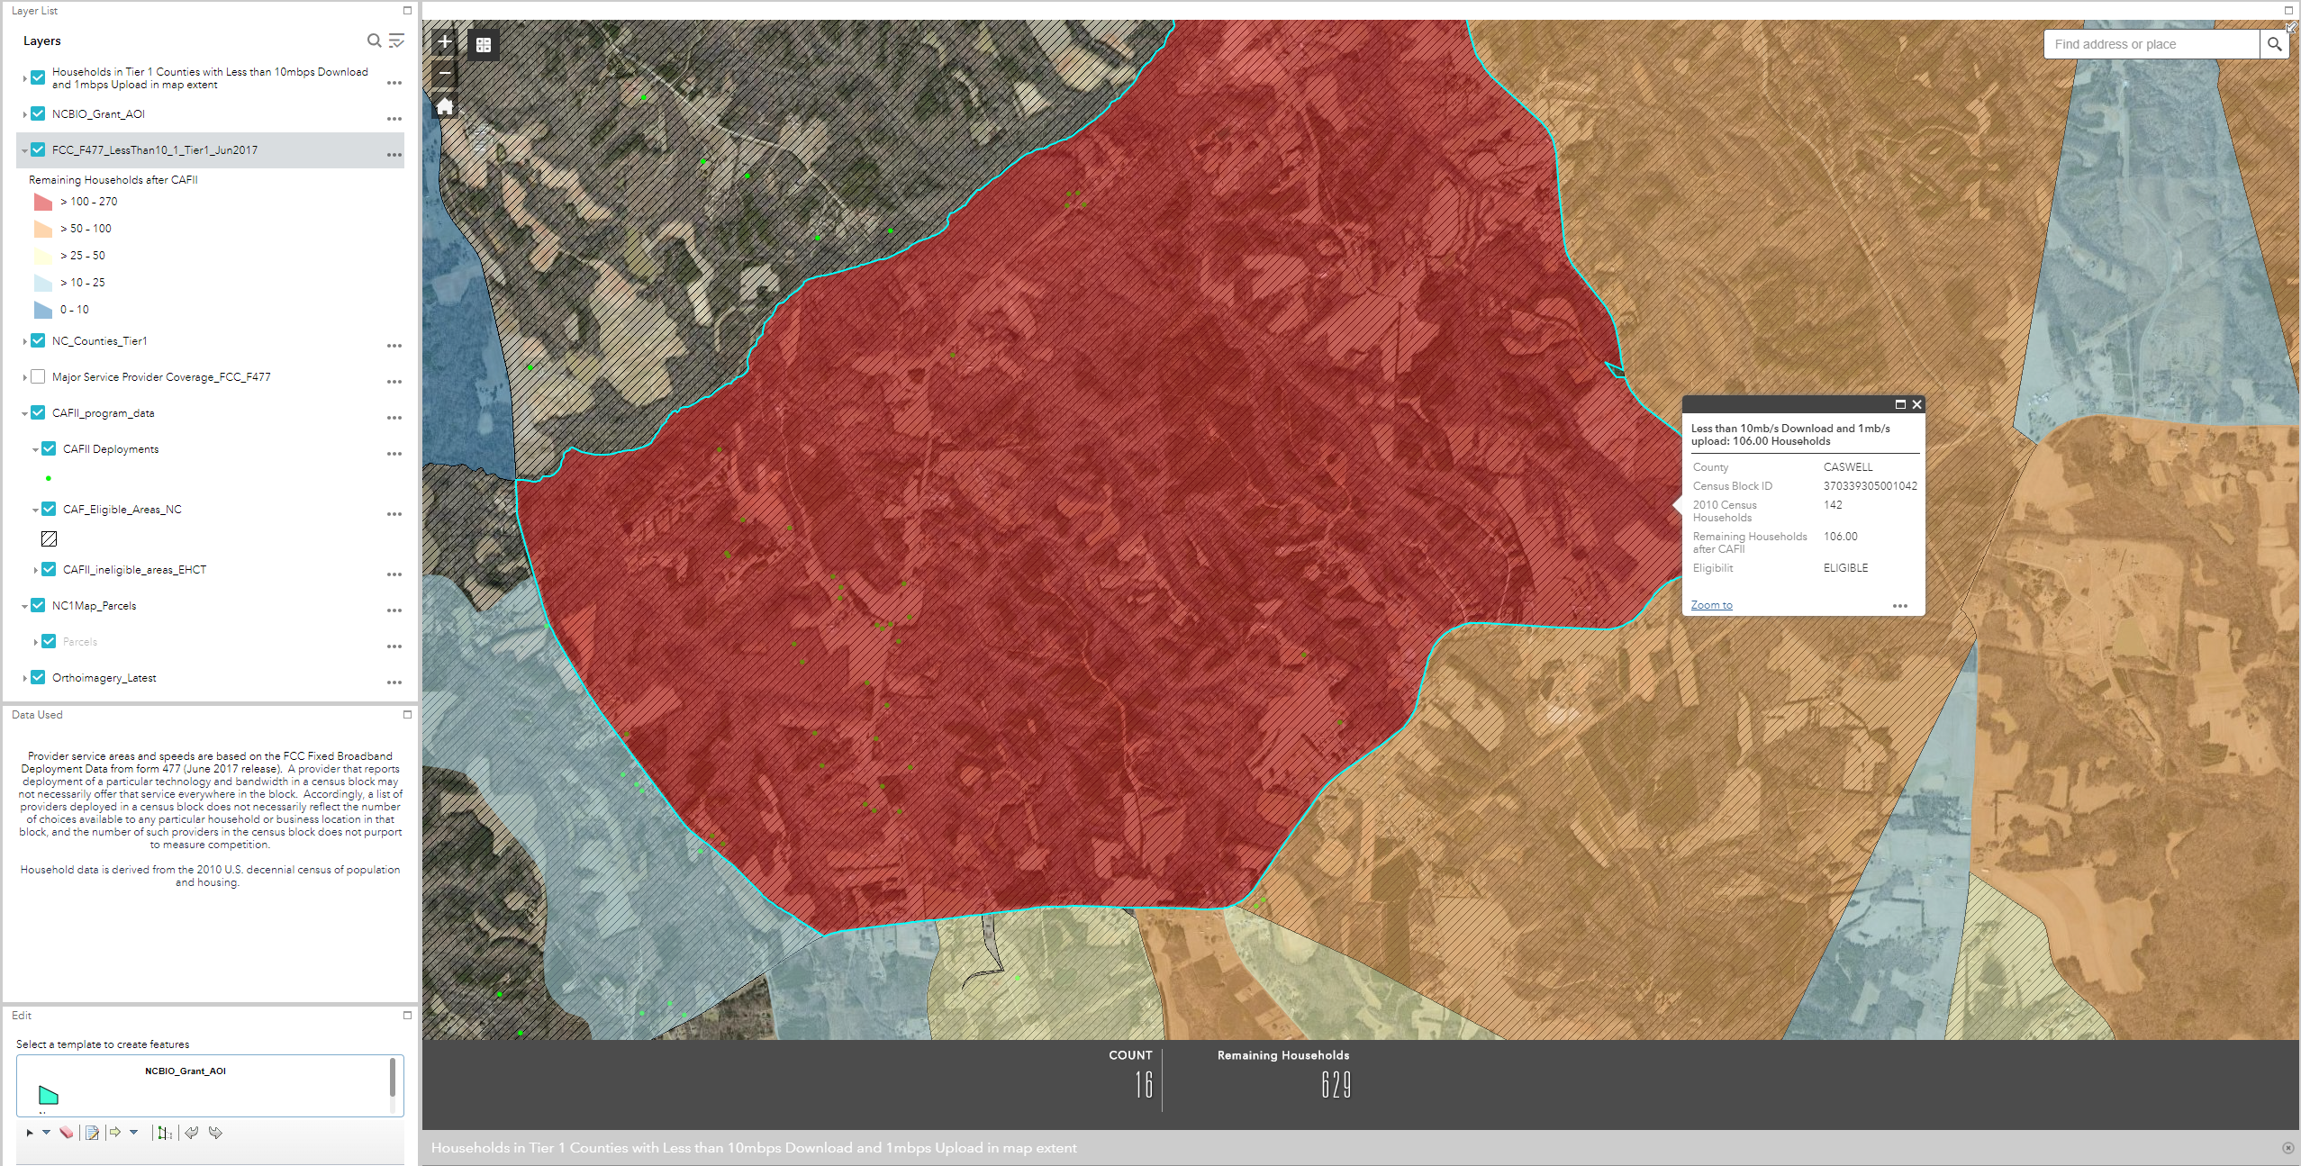
GREAT Grant Online Mapping Tool
https://bit.ly/2CGdpZ9
Click here first to then query map layer to see attributes
These layers only turn on when zoomed in far enough

Slide 23
Downloadable Shapefiles
From BIO GREAT webpage:
  Census block boundaries in the Tier One counties
  Census blocks with less then 10/1 Mbps, according to the FCC Form 477 Data (entire blocks) – and ineligible blocks for 2018
  CAF Eligible Areas (original CAF eligible areas from FCC)
From new USAC “CAF Map”:
  Location data for CAF builds to-date https://data.usac.org/publicreports/caf-map/

Slide 24
Identifying Eligible Areas – Other Data
Applicants may choose to utilize other sources of data, including field data, as part of their planning and application development
Protest Process is built into the Application Review Process, and BIO will conduct its own evaluation based on data available, including field tests when necessary

Slide 25
Guidelines & Program Walk Through
Application Materials

Slide 26
Application Materials Summary
Applicant
Project Area & Locations to be Served
Project Area & Locations to be Served
  Identity
  Statement of Qualifications
  Identify Partnerships
  Map
  Description of the area to be served
  ID # of homes, businesses, community anchor points, ag operations /processing facilities to be served
  Assessment of the current level of broadband access in the proposed deployment area
  Attestation the proposed project area is eligible

Slide 27
Application Materials Summary
Technical Report
Budget
Proposed services, Marketing, Adoption, & Community Support
  Detailed Narrative
  Explain Partnership, if applicable
  Explanation of work (in-house or contract)
  Timeline of Activities
  Total cost of the project
  Proposed area – infrastructure cost per household
  Amount to be funded by the applicant
  Description of services (proposed upstream & downstream)
  Any applicable data caps
  Proposed advertised speed to be marketed to end users
  Plan to encourage users to connect
  Evidence of support for the project

Slide 28
Guidelines & Program Walk Through
Protesting an Application

Slide 29
Guidelines & Program Walk Through
All Applications must be publicly posted for 30 days prior to award.
Notes:
All applications will be posted on our website 30 days – this is the protest window: Jan 26 – Feb 25.

Slide 30
Grounds for Protesting an Application
Proposed project area is NOT eligible.

Slide 31
An area is not eligible if:
10/1 Mbps service is available
Service will be made available by January 1, 2020 through another state or federal program, AND
    BIO notified prior to August 30, 2018

Slide 32
Every Protest Must:
Be in writing
Accompanied by all relevant supporting documentation

Slide 33
Decision Process
BIO will adjudicate: verifying data submitted with existing data & possibly field visits
Secretary the decider
Decision in writing
Decision at least 15 days prior to application approval

Slide 34
Decision Process
If protest granted in part, Applicant will be notified and will have 7 days to revise the application to:
    amend proposed project areas (ie: less locations deemed ineligible)
    revise budget

Slide 35
Guidelines & Program Walk Through
Scoring/Match

Slide 36
Scoring and Match
Competitive
Sliding points scale
Highest score receives priority for funding
Applicants will “self score” to determine match
NC BIO will review application and give “final” score
NC BIO will verify match requirement

Slide 37
Scoring Criteria
Scoring Matrix
Partnership
Unserved Households
Unserved Businesses
Cost per household in a region
Base Speed Multiplier
Community Broadband Planning
Households to be served

Slide 38
Sample Scoring Matrix
 |  | Applicant Review
Partnership - Projects involving a partnership or affiliation by a private provider with a nonprofit or not-for-profit, or a for-profit subsidiary with documentation that shows the partnership or affiliation will facilitate deployment and reduce cost per housing unit by utilizing the resources, facilities, & infrastructure of the partner or where the nonprofit or not-for-profit partner provides only financial support | 0 – No 5 – Documented Partnership | 5
Unserved Household - Using most recent FCC Data or supporting data, estimated number of unserved households within the eligible county (TIER ONE) | 700 or less – 1 701 to 1999 – 2 2000 and over – 3 | 3
Served Households – Using most recent FCC Data or supporting data, estimated number of households that will be served within the eligible project area | Under 150 – 1 150 to 249 – 2 250 and up – 3 | 3

Slide 39
Sample Scoring Matrix
 |  | Applicant Review
Unserved Business – Using most recent FCC Data or supporting data, provide broadband service to unserved business within eligible county (TIER ONE) and project area (Documentation) | 1 to 4 – 1 5 to 10 – 2 More than 10 or Ag. Operation/Ag. Processing Facility or a business with 31 or more full-time employees – 3 | 3
Piedmont or Coastal Region – Estimated Cost per Household | Up to $1,700/hh with partnership – 4 Up to $1,700/hh with no partnership – 9 $1,701 – $2,200/hh w/ partnership – 3 $1,701 – $2,200/hh w/ no partnership - 8 | 4

Slide 40
Sample Scoring Matrix
 |  | Applicant Review
Mountain Region – Estimated Cost per Household | Up to $2,500/hh w/ partnership – 4 Up to $2,500/hh w/o partnership – 9 $2,501 – $3,300/hh w/ partnership – 3 $2,501 – $3,300/hh w/o partnership – 8
 |  | Review
 |  | 18
Multiplier – Minimum download/upload | 10:1 – multiplier .95 25:3 – multiplier 1.35 | 1.35

Slide 41
Sample Scoring Matrix
 |  | Applicant Review
Score with multiplier | Totals | 24.3
Community Broadband Plan defined by NC BIO | No – 0 Yes – 1 | 1
 | Final Score | 25.3

Slide 42
Matching Funds
Determined by application score
Up to 50% of match maybe from third-party funding or other grants*
Highest score receives priority for funding
Match can be used only towards eligible project costs for GREAT
*USF, CAF, or state or federal program for broadband expansion shall not be used for match
55%
50%
45%
7.0 points or less
Greater than 7.0, but less than 14.0
Greater than 14.0, but less than 21.0
35%
21.0 points or greater

Slide 43
Sample Matching Funds Calculation
Application Score | 25.3
Total Project Budget | $1,000,000
Required Match | 35%
Great Grant Funds Requested | $650,000
Match Provided by Applicant | $350,000
Is the match adequate? | Yes
Application Score | Matching Requirement
7.0 points or less | 55%
Greater than 7.0, but less than 14.0 | 50%
Greater than 14.0, but less than 21.0 | 45%
21.0 points or greater | 35%

Slide 44
Guidelines & Program Walk Through
Contract Terms & Conditions Overview

Slide 45

Contract Terms
5-year agreement
Within 1 year of contract execution: construction, deployment, and service at the proposed speeds must be available
Proposed advertised speeds must stay in place for the duration of the 5-year agreement
Attestation of proposed broadband speeds or higher are available throughout the project area to end user connections
Notes:
.

Slide 46
Contract Terms – Annual Progress Report
# of households, businesses, agricultural operations, and community anchor points that have access as result of this project
% of end users in the project area that access and subscribe to service
Average monthly subscription cost
Disclosure of any changes to data caps if different from the application
*Contract terms will be detailed in the
grant agreement
Notes:
.

Slide 47
Contract Terms – Clawback Provision
A grant recipient shall forfeit the amount of the grant received if it fails to perform, in material respect the obligations established in the agreement.
  Breach includes failure to provide the minimum advertised connection speed
Amount forfeited: the amount disbursed plus interest at a rate per NCGS 105-241.21 (interest on taxes).
Notes:
.

Slide 48
The Portal
Using the Web-based Application
Notes:
Online, no paper,

Slide 49
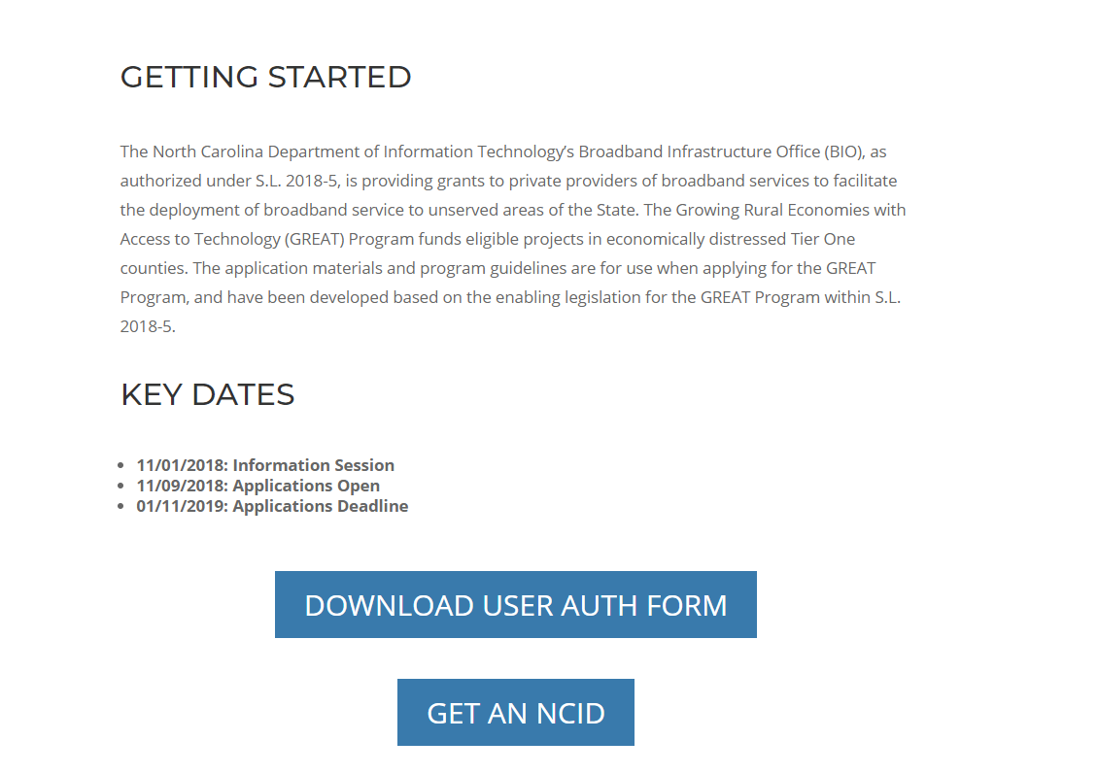
ncbroadband.gov/great-grant-getting-started
Notes:
Here is where you start /greatgrant

Slide 50
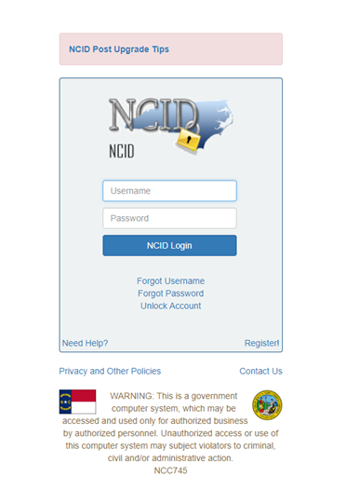
Notes:
You will also need a User Auth which we’ll have in your packet and send back to us PDF/email

Slide 51
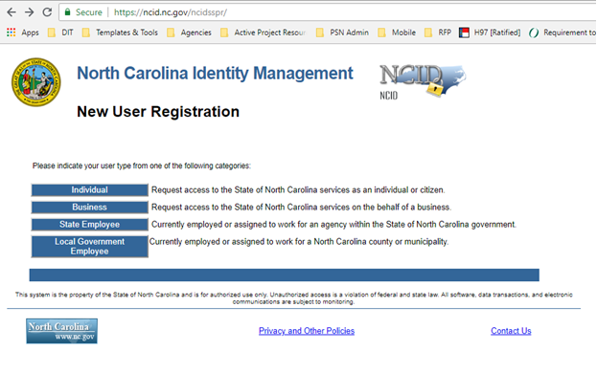

Slide 52
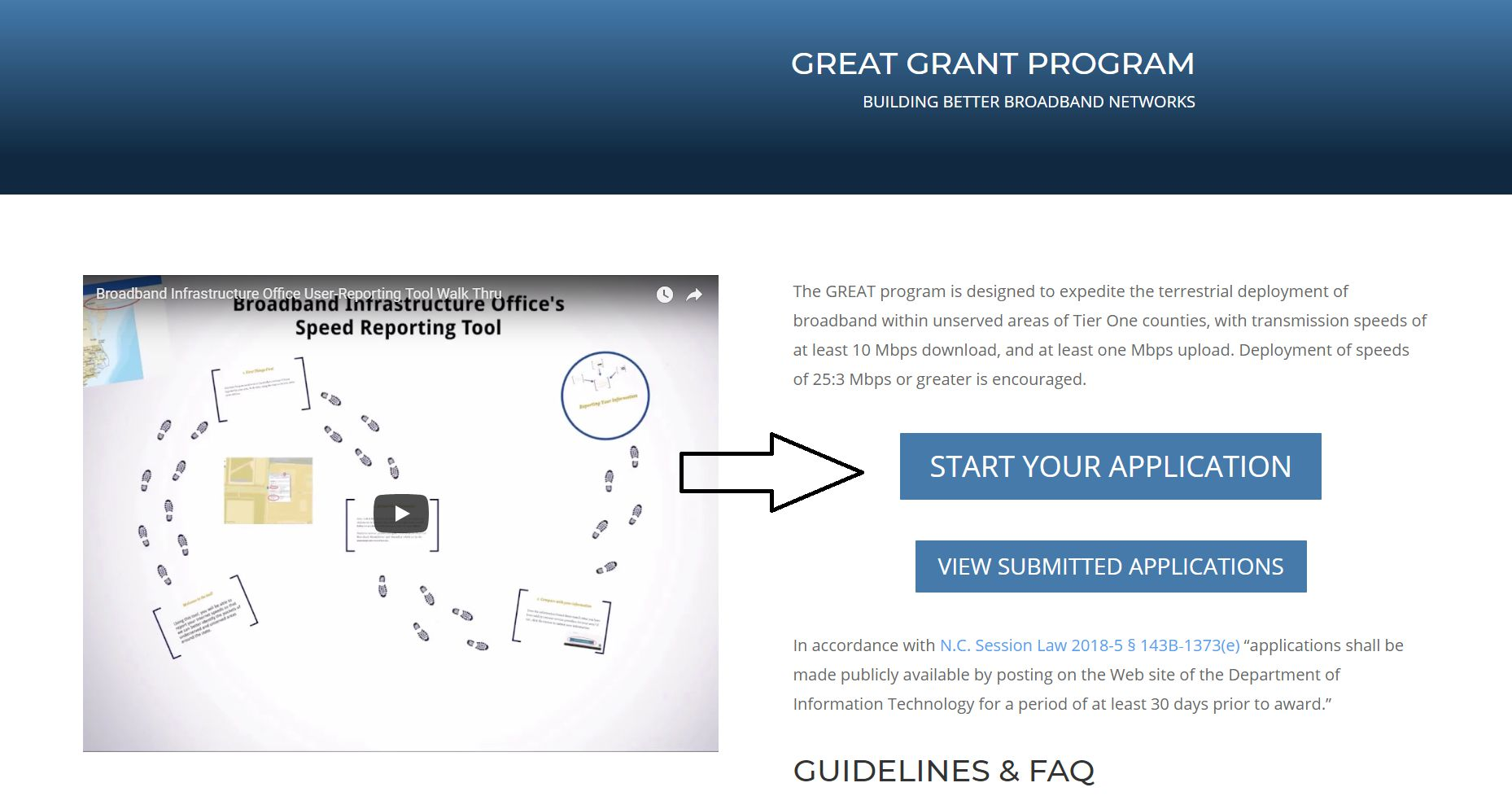
Notes:
Here is where you start /greatgrant

Slide 53
Get Help
GREAT Questions
ncbroadband.gov/greatgrant
Public Posting of FAQ
Application Help: SAP Support Services Team
NCID Support
it.nc.gov/ncid/
919-707-2208
GREATGrant@nc.gov
919-754-6000
DOTITSAPSupportServices@ncdot.gov

