Slide 1
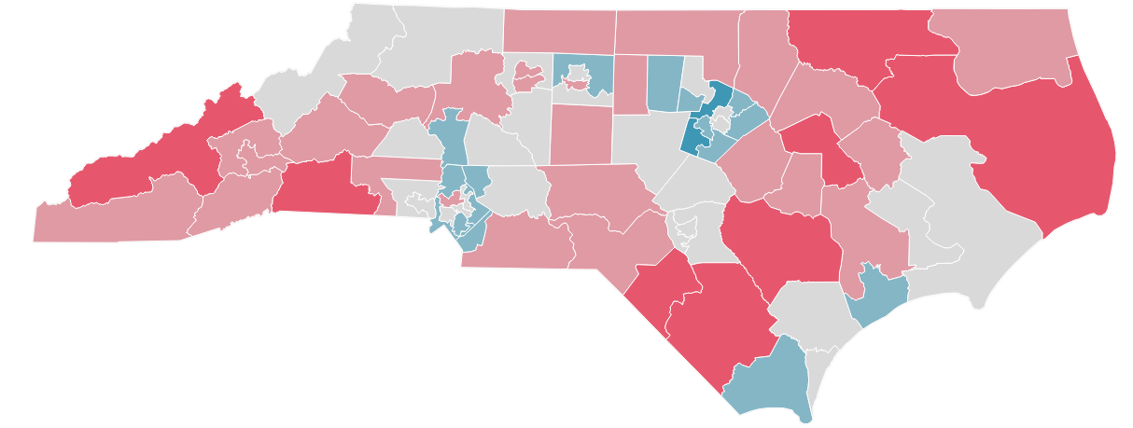
The Digital Divide in North Carolina¹
Approximately 1.1 million North Carolina households lack access to high-speed internet in their homes² and cannot afford it. Many residents also lack the skills to effectively use it. We can achieve digital equity in North Carolina by addressing the following factors:
Infrastructure
At least 266,000 North Carolina households, likely much higher, currently do not have access to high-speed internet of 100/10+ due to lack of infrastructure.³
Percent of Households Without a High-Speed Internet Subscription (2019)⁷
Affordability
Approximately 1.3 million households would have to pay more than 2% of their annual income to afford a broadband cost of $60/month.⁴
Digital Literacy and Enablement
An estimated 430,000 households are without a home laptop or desktop computer. Of those, approximately 180,000 do not have a smartphone.⁵ As many as 1.2 million adults may lack the digital literacy required to begin taking advantage of digital services.⁶
% of households
0%
50%
1. Data on this slide is based on a 2021 study by McKinsey & Company. | 2. U.S. Census Bureau, 2019 American Community Survey (ACS) Microdata | 3. FCC Form 477, FCC 2019 block demographic estimates | 4. U.S. Census Bureau, 2019 American Community Survey (ACS) Microdata | 5. U.S. Census Bureau, 2019 American Community Survey (ACS) Microdata; 2021 Census Pulse Survey | 6. National Center for Education Statistics | 7. U.S. Census Bureau, 2019 American Community Survey (ASC) Microdata, for respondents who don't have an internet subscription or that only have cellular data or only have dial-up, satellite or other.

Slide 2
Closing the Digital Divide in North Carolina
By 2025, North Carolina will become a top-5 state for high-speed internet adoption rates while equitably eliminating North Carolina’s digital divide by:
Making home internet subscriptions affordable to all households, especially those with children
Making targeted investments to close gaps in adoption that impact Native American, Black and Latinx households
Catalyzing access to devices, digital training and tools that will connect residents to the digital economy

Slide 3
Measuring Success
Key Success Metrics
N.C. Today
N.C. 2025
Households with broadband internet access
95.5%
98%
Households with broadband internet subscriptions
73%
80%
Households with children with broadband internet subscriptions
81%
100%
Adoption rates across racial subgroups
Native American
57%
80%
64%
80%
Black
Latinx
68%
80%
White
76%
80%

Slide 4
Approach & Initiative Investment
Governor Cooper proposes closing the digital divide with a $1.2 billion state investment, using funds from the American Rescue Plan, in the following areas to achieve digital equity in North Carolina. We will also leverage significant private sector investment.
Infrastructure
$600M
Ensure availability of internet service at speeds of at least 100/20 Mbps for more than 98% of North Carolina households.
$350M
GREAT Grant 2.0
$150M
Competitive Bidding
$100M
Stop Gap Solutions
Affordability
$420M
Lower cost barriers for North Carolinians.
Digital Literacy and Enablement
$165M
Improve awareness and enable North Carolinians to realize the benefits of high-speed internet through digital literacy and upskilling aimed at accessing the digital economy.
$70M
Device Support and Break-Fix Services
$95M
Awareness and Digital Literacy
Administrative
$15M
Operational support.

